Slide 1
Dynamic programming

Slide 2
theory
Dynamic Programming helps you solve difficult problems into easier task to improve and speed up the process of the root to get.
In this case we will use yet again Tasks 1 example to help us understand.

Slide 3
Example
As you can see we take in this case delta to see if we can recreate the fastest root with the lowest weight.
Beta
40
10
12
Alpha 20
14
25
Gamma
70
15
12
28
20
17
Epsilon 30
Delta
10
17

Slide 4
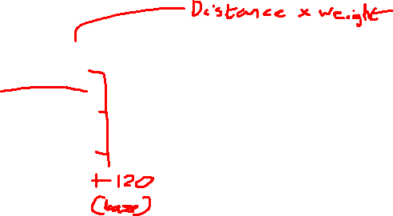
Steps
Beta
40
Starting from Delta we need to check all the possible option available and look for the cheapest one
10
12
Alpha 20
14
25
Gamma
70
15
12
28
20
16
Epsilon 30
Delta
10
17
D to A(120) | D to G(160) | D to E(170) | D to B(250)
D A B(420) | D G B(1120) | D E B (730) | D B A (750)
D A G (570) | D G A (1360) | D E A (970) | D B G(850)
D A E (720) | D G E (2400) | D E G (1290) | D B E (950)

Slide 5
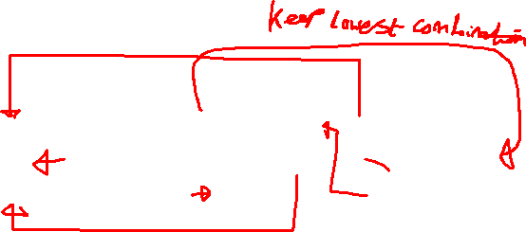
Steps
Beta
40
A finding the values I see multiple of the same combinations, and so I will remove the higher values one to keep the pair with the lower value.
10
12
Alpha 20
14
25
Gamma
70
15
12
28
20
16
Epsilon 30
Delta
10
17
D to A(120) | D to G(160) | D to E(170) | D to B(250)
D A B(420) | D G B(1120) | D E B (730) | D B A (750)
D A G (570) | D G A (1360) | D E A (970) | D B G(850)
D A E (720) | D G E (2400) | D E G (1290) | D B E (950)
D A (120) | D E(170) | D B (250)
D A B(420) | D E B (730) | D B G(850)
D A G (570) | D E G (1290)
D A E (720)

Slide 6
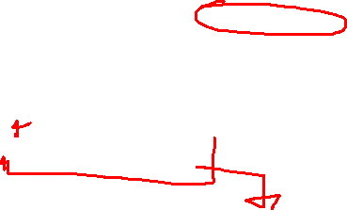
Steps
After sorting the options from the first selection it’s time to go further down in the problem and check for the faster root.
And yet again just keep the lowest cost pair
D A (120) | D E(170) | D B (250)
D A B(420) | D E B (730) | D B G(850)
D A G (570) | D E G (1290)
D A E (720)
D A B E(1400) | D E B A (1530) | D B G A(2650)
D A B G (1260) | D E B G (1690)
D A G B (1770)
D A G E (3370) | D E G A (3070) | D B G E (4210)
D A E B (1560) | D E G B (2740)
D A E G (2400)

Slide 7
Steps
As for the last option we can double check the options and see that there are only ¾ remaining.
D A (120) | D E(170)
D A B(420) | D E B (730)
D A G (570) | D E G (1290)
D A E (720)
D A B E(1400) | D E B G (1690)
D A B G (1260)
D A E G (2400)
D A B E G (4200) | D A E G B (3960)
D A B G E (5180) | D E B G A (3940)

Slide 8
Answer
As we can see we do not get the cheapest result like the brute force shows us, but we can still see that it is lower than the average sum from almost all the 120 possibilities available.
This tells us that with this method you might not always be able to find the answer you want but something close to it that wouldn’t disappoint.
D E B G A (3940)

